Slide 1
AOOP-A-P
By: Arturo Olmos, Jaehyeon Park

Slide 2
How did I use Object-Oriented Programming?
Abstraction
We used abstract classes and interfaces. Abstract classes helped define a structure for those classes that were inherited, for example, our abstract class Account contained fields and methods that every account should have. We also used interfaces which helped in providing abstraction by hiding away the functionality of our code in classes that implement our interfaces.
Encapsulation
We used encapsulation for our Customer object with many fields that should not be accessed directly. We made the fields private and created the setters and getters method that gives us access for modifying the variables. Therefore, the private variables could be stored safely and prevent direct modification.
Polymorphism
Polymorphism was used to overload methods to get more parameters and to override methods to access abstract classes' methods.
Inheritance
We also used inheritance since we had abstract classes already defined. We inherited front them instead of rewriting redundant code.

Slide 3
How did I use Object-Oriented Programming?cont.
How did I create objects?
We created objects by reading from files that were provided to us and stored the data within those files accordingly.
We also created objects based on need, such as a menu object to display something to the user.
How did I store objects?
we stored objects by putting them in a HashMap.
How did objects interact with each other?
In our case we had Object used for storing data. These objects are used to access data and to update them based on actions from a user. We also had objects that helped handle tasks, such as handling a transaction. Lastly We used menu objects to put everything together, since from the menu data can be accessed and actions can be performed.
How is my code modular?
I would say that it is modular since we followed our UML class diagram

Slide 4
How did I use Object-Oriented Programming?cont.
How is my code modular?
It follows everything that is described in our UML diagrams
How did I use interfaces?
We used interfaces to abstract away the actions that can be applied to a collection and an iterator.
Explain how the code is maintainable
The code is maintainable because extending and modifying the code is very simple. It is maintainable because for example the system as a whole is broken into parts and modifying the code does not require to modify the system as a whole instead you only need to modify a part of it.

Slide 5
How did I use Design Patterns?
Briefly discuss your approach and use of design patterns
We used the singleton and iterator design patterns, the singleton design pattern was used in the Transactions class and the Iterator design pattern was implemented by creating our own Collections and Iterator interfaces. We then implemented the Collections interface in the CustomerCollection and ItemCollection class. The Iterator interface was implemented in the CustomerCollectionIterator and ItemCollectionIterator class.
Describe which design patterns you used
The singleton design keeps a single instance of the class within itself as a field. The single reference of the instance can be accessed through a method such as getInstance(). Then the Iterator design pattern allows the sequential access of objects and without exposing the data structure that was used in the implementation.

Slide 6
How did I use Design Patterns?cont.
•Describe why you used the design patterns you used
We used the Singleton design pattern to keep a single instance of the Transactions class since not more than one is needed. And as for the Iterator design pattern we used it because it was a helpful way to iterate over a HashMap without exposing that it was a HashMap since.
•Describe how they were used
The singleton design pattern was used to access methods within the Transactions class, which are used in the . And the iterator design pattern was used to iterate over a HashMap when Searching for customers. The iterator design pattern was also used to print all the Item found in a HashMap.

Slide 7
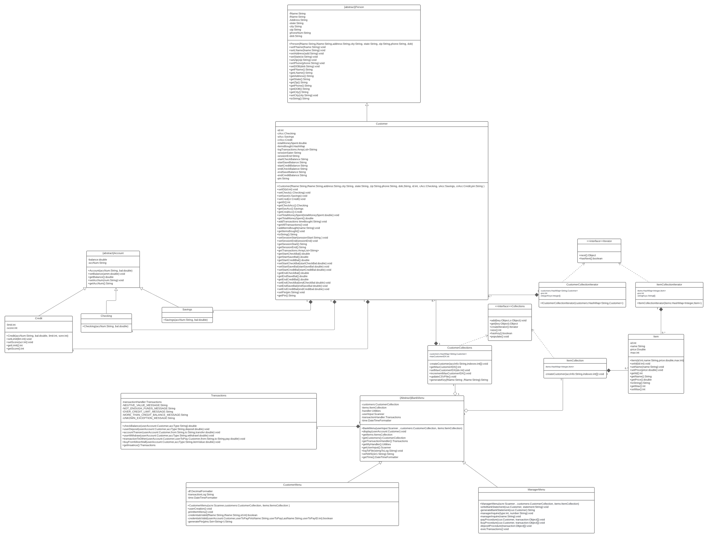
UML Class Diagram (Entire Diagram)

Slide 8
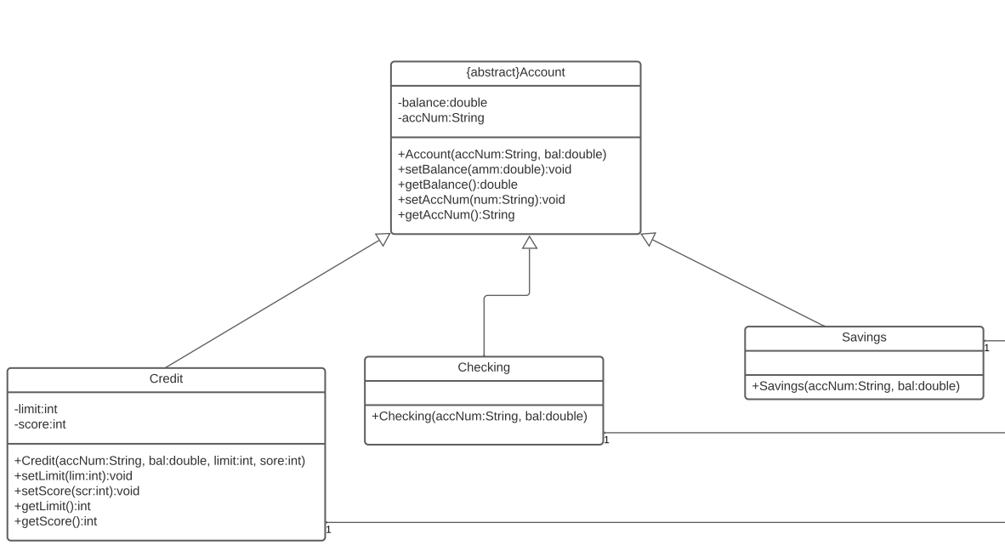
UML Class Diagram (Account/Children)

Slide 9
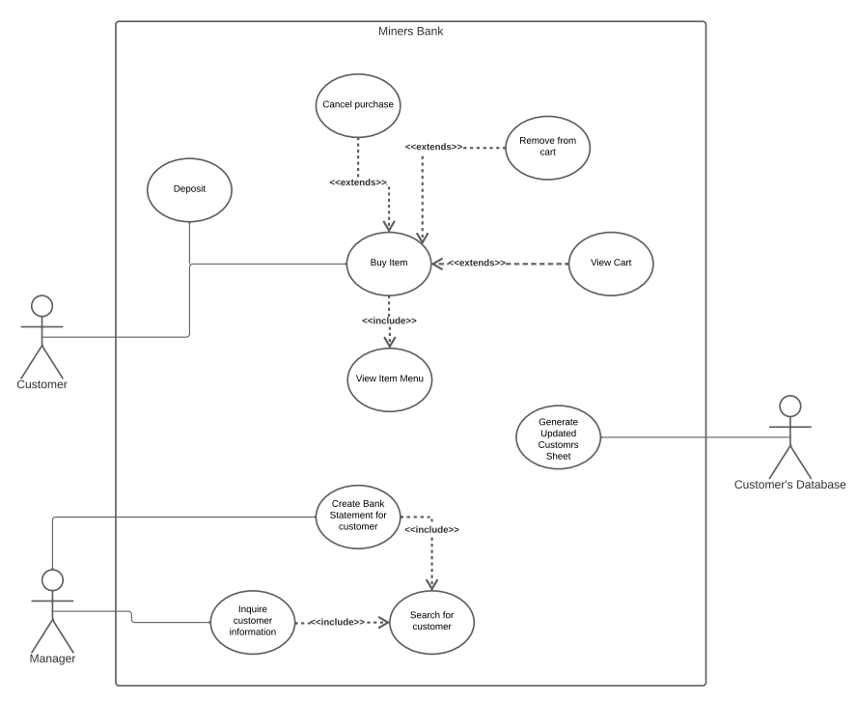
UML Use Case Diagram

Slide 10
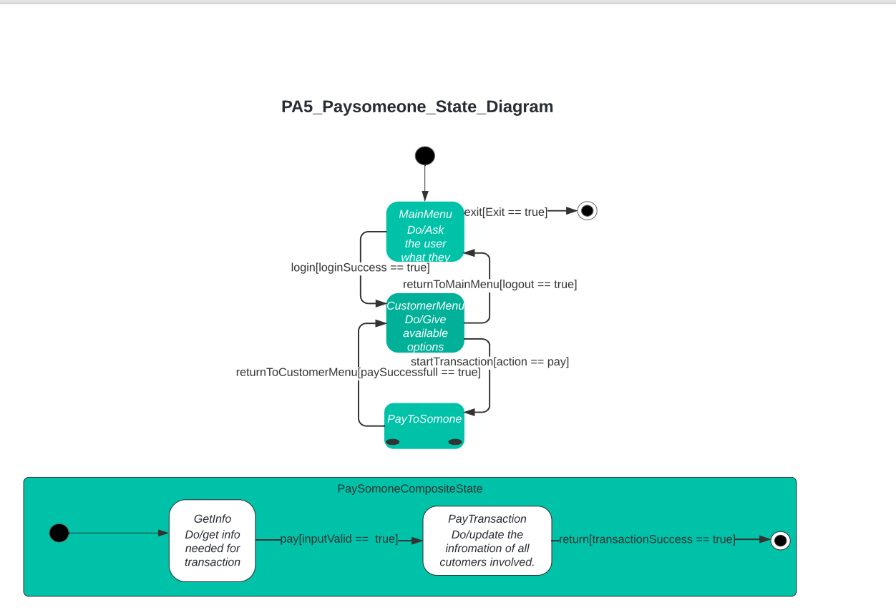
UML State Diagram (Pay Someone)

Slide 11
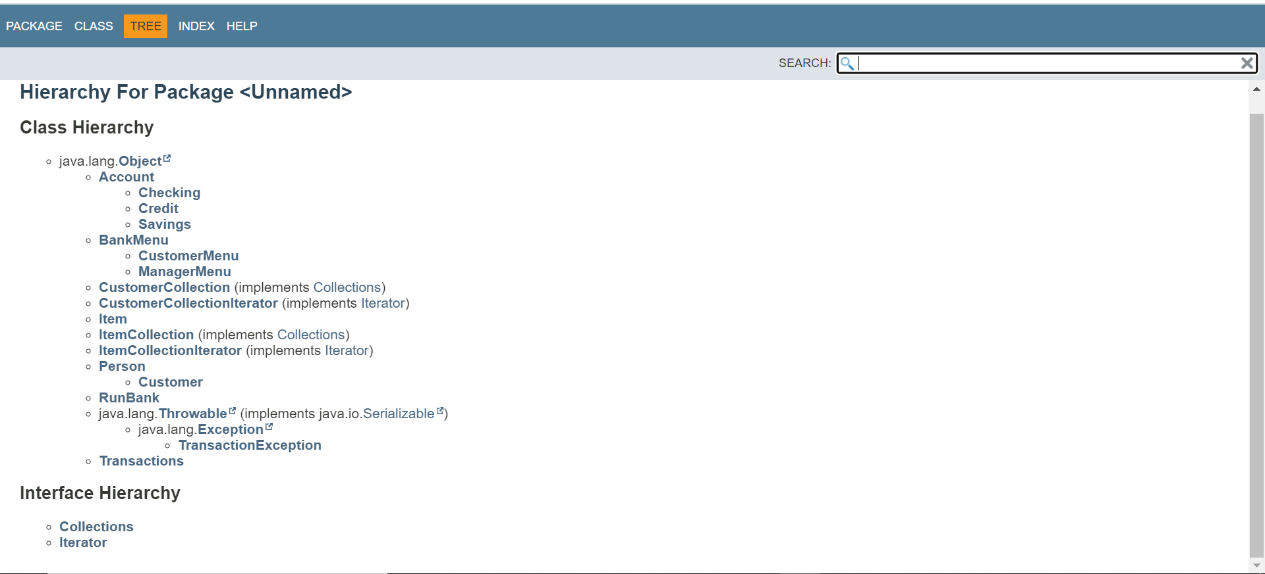
Javadoc

Slide 12
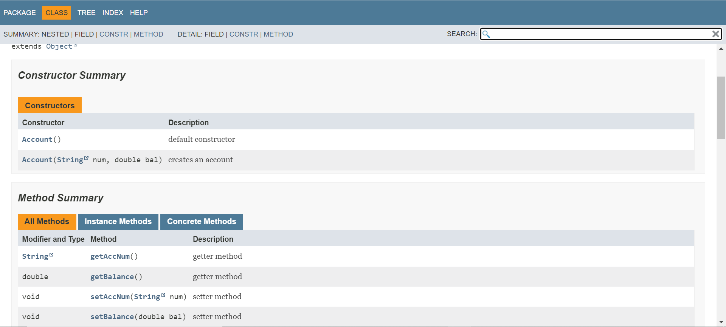
Javadoc(cont.)

Slide 13
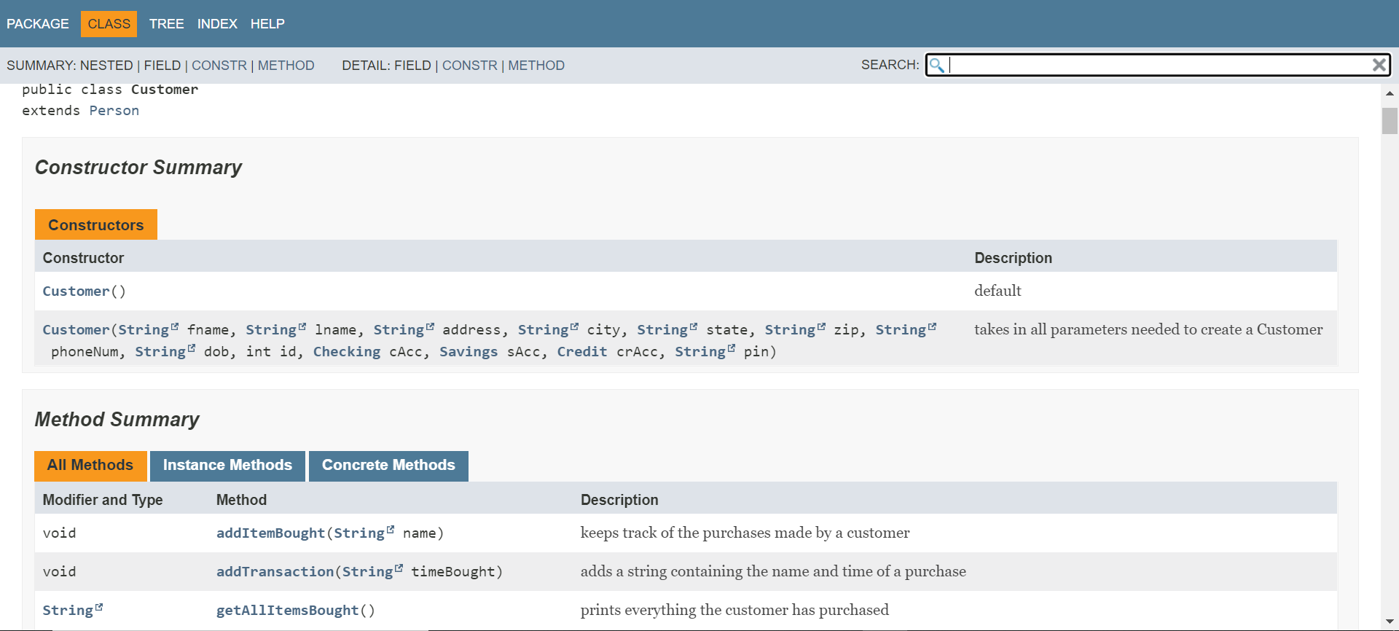
Javadoc(cont.)

Slide 14
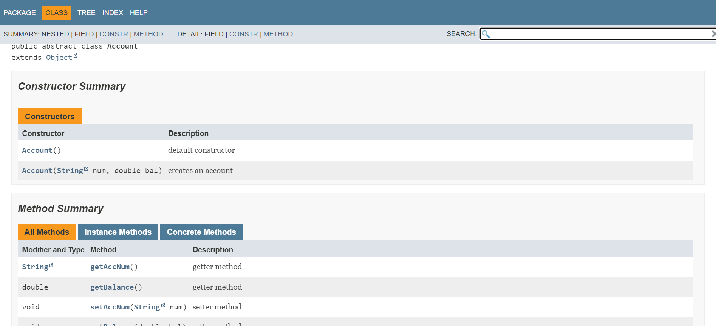
Javadoc(cont.)

Slide 15
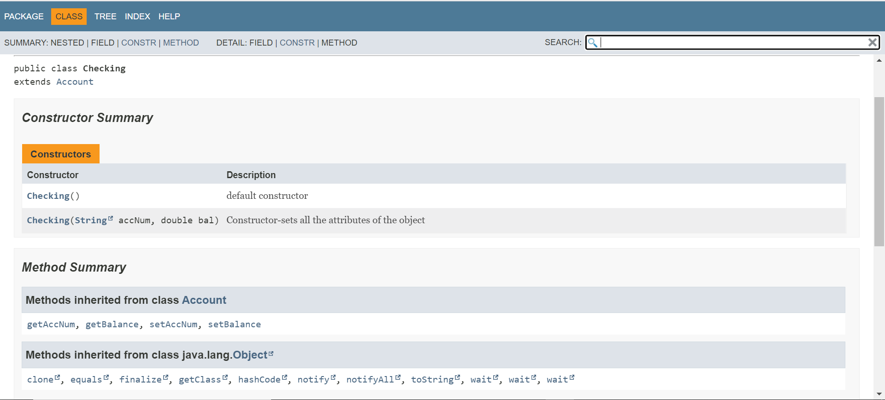
Javadoc(cont.)

Slide 16
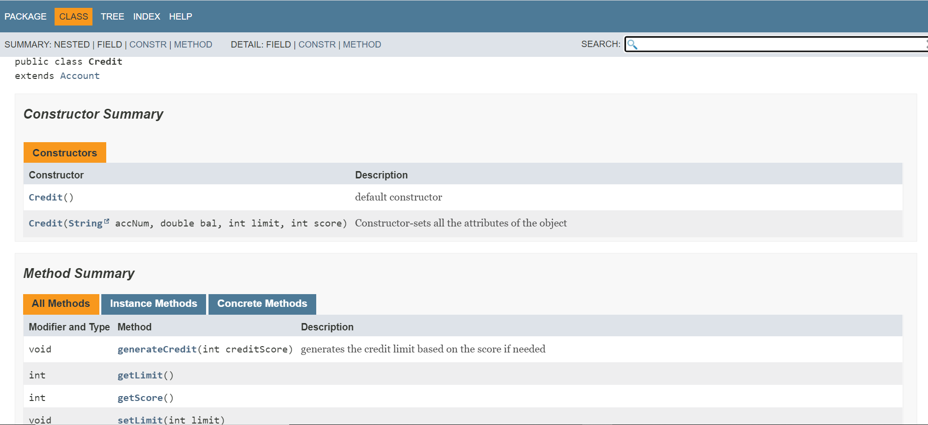
Javadoc(cont.)

Slide 17
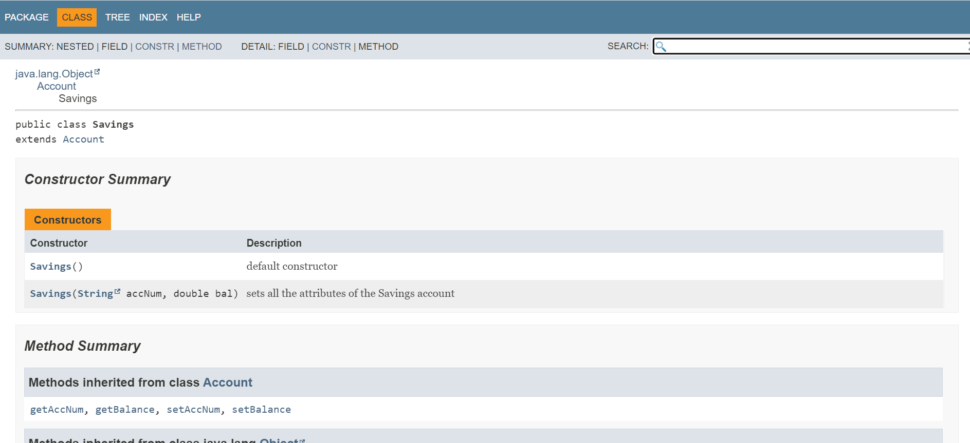
Javadoc(cont.)

Slide 18
Reflections
Did these assignments challenge you?
I think that yes we were challenged, we would say that implementing new concepts was probably the biggest challenge, such as trying to properly describe relationships between classes in the UML class diagram.
What was the easiest/hardest parts of these assignments?
I would say the easiest part of this assignment was the coding part. And the hardest was testing the code and making sure the everything worked well, since no matter how much testing we did at the end we still managed to find a small bug.
What did we learn with this assignments?
I would say that we learned how to implement OOP concepts into actual code.
How did we grow as a student?
We grew as students since we learned how to work on a bigger assignment and also how to work with others.
How did we break up the problem to complete this task?
Through the discussion, Arturo got most of coding part and Jay got the documentation parts. Then we helped and supported each other's work.
How did you all grow in this course?
We got a better understanding about object oriented programming and an experience implementing a program that requires using all the knowledge.

Slide 19
References (If applicable):
https://www.tutorialspoint.com/design_pattern/iterator_pattern.htm

